Slide 1
Automated ELK stack development
Tanveer KHan

Slide 2
Table of contents
This document contains the following details:
Description of the Topology
Access Policies
ELK Stack Configuration
Beats in Use
Machines Being Monitored
How to Use the Ansible Build

Slide 3
Description of the topology
The primary objective of this network is to offer a load-balanced and monitored instance of the D*mn Vulnerable Web Application, or DVWA.
Load balancing ensures that the application is highly available for clients while also limiting network threats. Services will continue even if a server goes down or needs to be updated.
The benefit of deploying a jump box is that only the jump box can use SSH to connect to the virtual network.
Users can quickly monitor the susceptible VMs for changes to the logs and system traffic by integrating an ELK server.
Filebeat keeps track of the specified log files or locations, gathers log events, and sends them to Elasticsearch or Logstash for indexing.
Metricbeat is a metric shipper that is exceptionally simple to use, efficient, and effective for monitoring your system and the operations that operate on it.

Slide 4
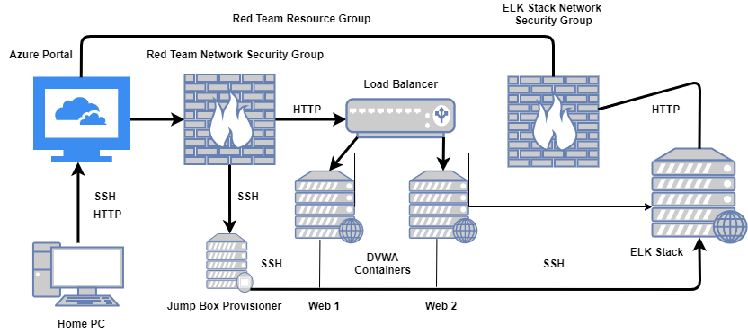
Network Topology

Slide 5
The Network
Below are the configuration details for each machine:
Name | Function | IP Address | Operating System
Jump Box Provisioner | Gateway | Public: 40.86.73.173 Private: 10.0.0.8 | Linux
Web-1 | Server | Private: 10.0.0.9 | Linux
Web-2 | Server | Private: 10.0.0.10 | Linux
ELK Stack Server | Monitor | Public: 52.137.81.98 Private: 10.2.0.4 | Linux

Slide 6
Access policies
The machines on the internal network are not exposed to the public Internet.
Only the Jump Box Provisioner machine can accept connections from the Internet.
Access to this machine is only allowed from the following IP addresses:
5061 Kibana port
Machines within the network can only be accessed by the Jump Box Provisioner.
A summary of the access policies in place can be found in the table below:
Name | Publicly Accessible | IP Address
Jump Box | Yes | 73.73.60.19
Web-1 | No | 10.0.0.5
Web-2 | No | 10.0.0.6
ELK Stack | No | 10.0.0.4

Slide 7
Elk stack configuration
The ELK virtual machine's configuration was automated using Ansible. There was no manual configuration, which was beneficial because it was simple and prevented any easily refuted weaknesses.
The playbook implements the following tasks:
Install docker.io
Install python3-pip
Install docker via pip
Increase virtual memory
Download and launch a docker ELK Stack container – This initiates docker and establishes the ports being used.
The following screenshot displays the result of running docker ps after successfully configuring the ELK instance:

Slide 8
Target machines & beats
This ELK server is configured to monitor the following machines:
I have installed the following Beats on these machines:
Name | IP Address
Web-1 | 10.0.0.5
Web-2 | 10.0.0.6
Name | IP Address
Web-1 | 10.0.0.5
Web-2 | 10.0.0.6
ELK Stack Server
We may obtain the following data from each machine using these Beats:
Filebeat gathers log information and displays it in monitoring clusters.
Metricbeat gathers metrics and statistics and displays them in a given output, such as Elasticsearch or Logstash.

Slide 9
Using the playbook
In order to use the playbook, you will need to have an Ansible control node already configured. Assuming you have such a control node provisioned:
SSH into the control node and follow the steps below:
Copy the playbook (.yml) file to Ansible directory. /etc/ansible
Update the host file to include webserver and ELK.
Run the playbook and navigate to Kibana to check that the installation worked as expected.
( http://[your.VM.IP]:5601/app/kibana )
If successful, you should see the following webpage:

Slide 10
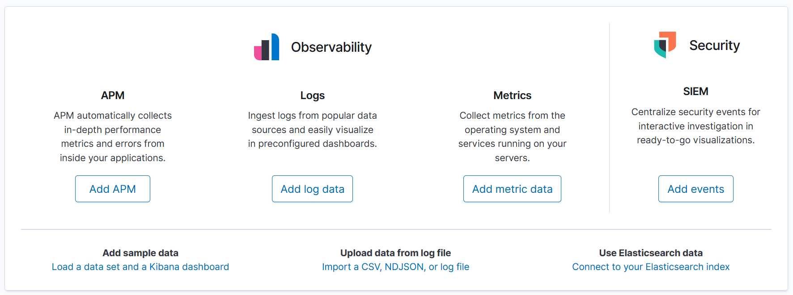
Congratulations on your first step toward network automation!

